Slide 1
Attrition in Fortune 100 Companies
Joshua Turk
Notes:
Hello and thank you for watching my presentation, my name is josh turk and today we will be talking about attrition and the factors that influence it in Fortune 100 companies

Slide 2
Introduction
In what jobs are we seeing attrition?
Is job satisfaction a factor in attrition?
How can we best predict monthly income and does this relate to attrition?
How can we best predict attrition?
Notes:
So to start off with Im going to give a quick overview of the data that was used for this analysis. Next we want to take a closer look at which jobs roles are seeing the most attrition. Then we want to take a look at job satisfaction scores. From there we will look at payment and build a model to predict monthly salary as best we can. And then finally we will be building a model to predict attrition.

Slide 3
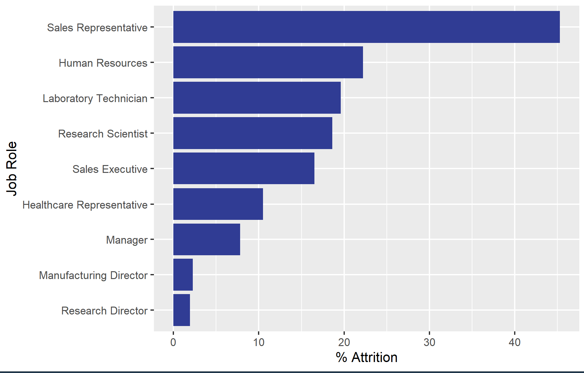
Attrition by Job Role
Notes:
Here we can see each job role and the percentage of people leaving within that job role. Our top attrition rate is going to be sales representatives with around 45% attrition, about double that of the next highest attrition rate in Human Resources. At the bottom we have the directors and managers which lines up with expectation

Slide 4
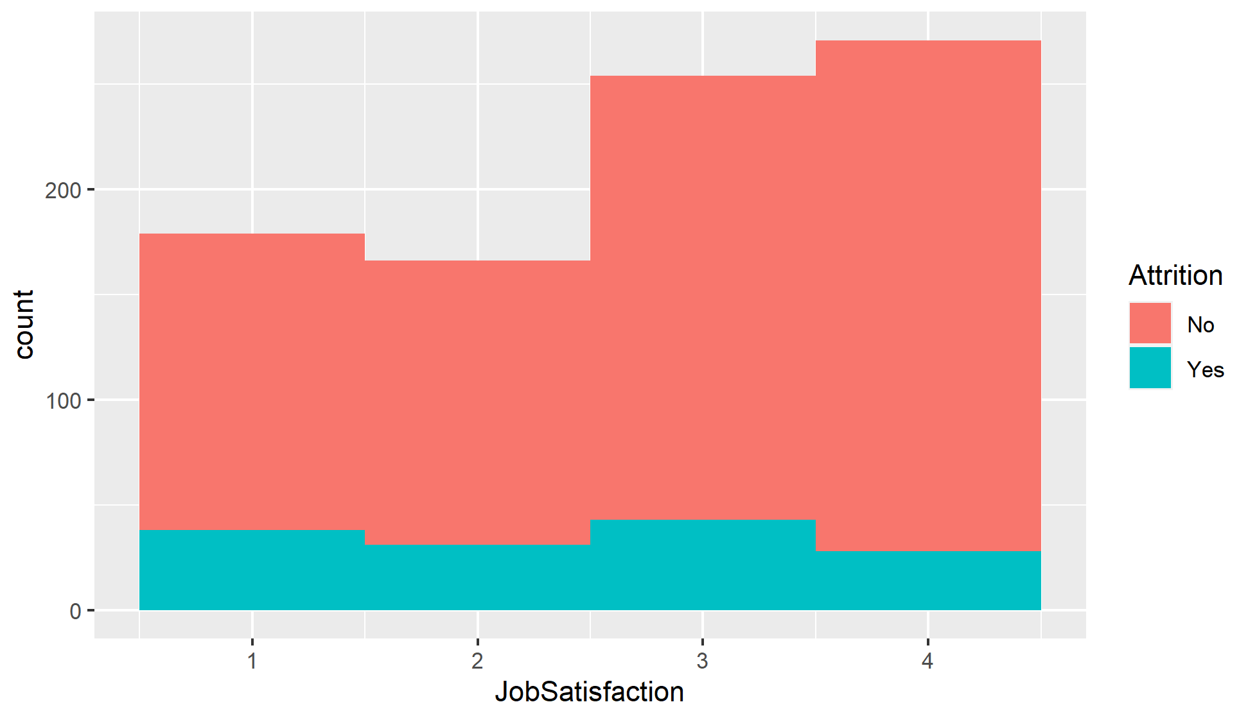
Job Satisfaction
With a p-value of 0.001497, there is enough evidence to suggest that the mean job satisfaction scores for those that left the company are different than those that stayed.
Notes:
Now we want to take a look at job satisfaction. Here we can see the distribution of job satisfaction scores, separated by whether or not the person was lost to attrition. Those that stayed have a more left skewed distribution with a majority responding with 3s and 4s. Underneath that we can see that those that left the company have a much flatter distribution. To be certain, we ran a two sample t-test and came to the conclusion that the mean job satisfaction scores for those that left are lower than the scores of those who stayed. If you are interested in a more detailed analysis please see the rmarkdown file linked at the end of the presentation.

Slide 5
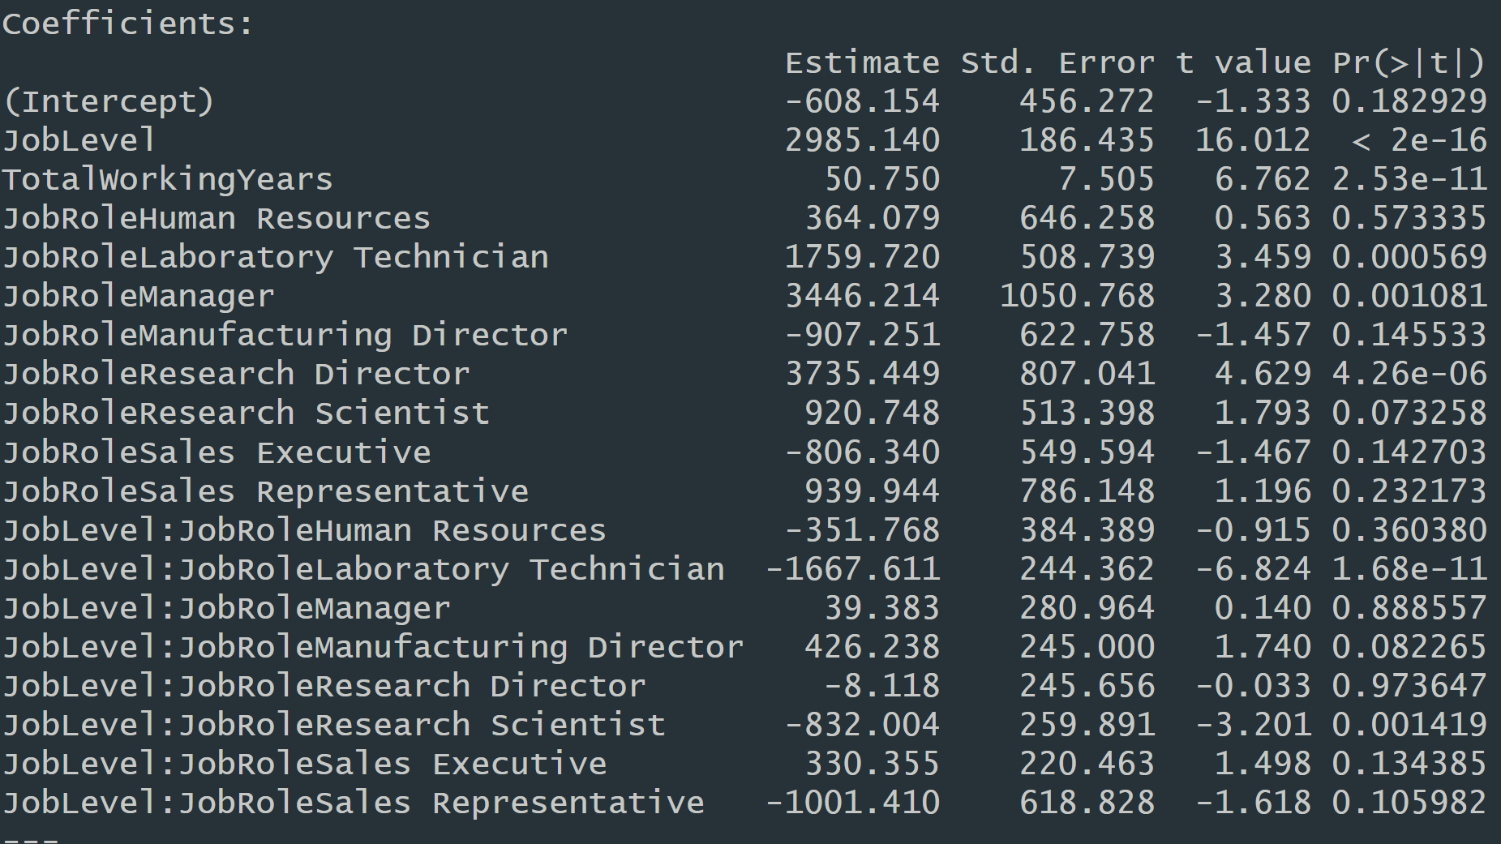
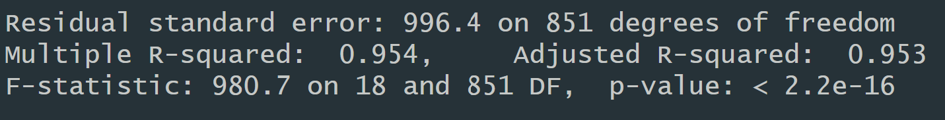
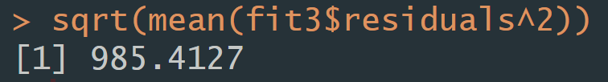
Monthly Income - Prediction and Attrition
R^2 = 0.954
Adj. R^2 = 0.953
RMSE = 985.4127
With a p-value less than 0.0001, there is strong evidence to suggest that the mean monthly income of those that left the company is less than that of those that stayed. We are 95% certain that this difference is between -2654.047 and -1220.382.
Notes:
Here we created a linear regression model to predict monthly income. Our best model used JobLevel, TotalWorkingYears, JobRole, and an interaction term for JobLevel and JobRole to allow for different relationships with each job role. This model gave us an adjusted r^2 of 0.953, meaning we are explaining about 95% of the variation in monthly income with our chosen model.

Slide 6
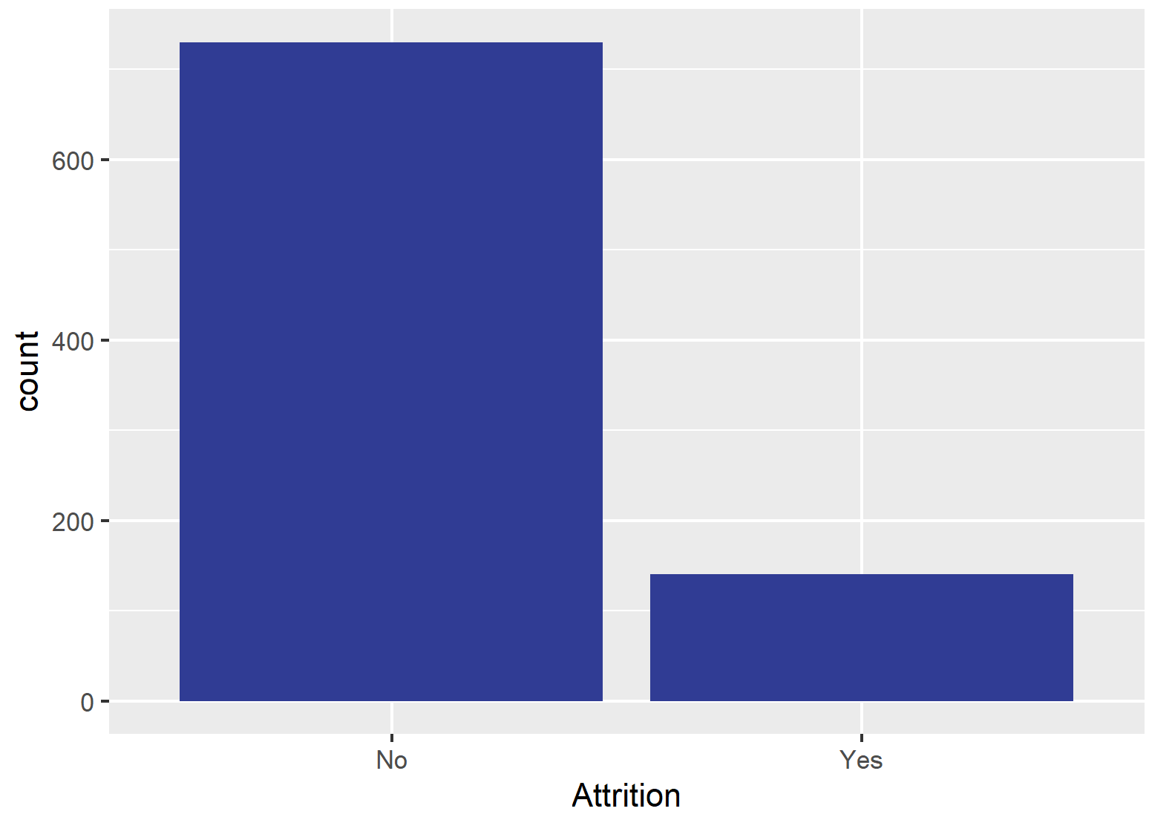
Attrition Model - Data
Unbalanced Data
Upsampling to preserve observations
Caution: can lead to overfitting
Notes:
Here we can see the count of attrition from the original data. Because these outcomes are so imbalanced, we have decided to upsample the data which means randomly duplicating observations that have yes for attrition. This will make it so we can get a balanced sensitivity and specificity. However we will proceed with some caution as doing this can lead to an overfitted model.

Slide 7
Attrition Model
 | No | Yes
No | 123 | 10
Yes | 66 | 19
Model Type: kNN
Accuracy = 0.6514
Sensitivity = 0.6508
Specificity = 0.6552
Predictors Used: 29
Notes:
Here we have our predictive model for attrition. We created a kNN model with upsampled data to create a balanced dataset. Using 29 predictor variables, we can correctly guess whether an employee will leave due to attrition about 65% of the time and our sensitivity and specificity are well balanced. While this accuracy may seem low, it does allow you to focus your time and efforts on specific employees that are likely to be lost due to attrition.

Slide 8
Thank you!
jturk@smu.edu
https://josh-turk.github.io/
Notes:
That brings us to the end of this presentation, thank you for your time and I hope i was able to provide some useful information. Please email me any questions you might have and for a more detailed analysis please see my github page linked here. https://youtu.be/b8qVZO8sTnY

